Slide 1
Analysis Of Reviews Of British Airways
By
Koustav Dey

Slide 2
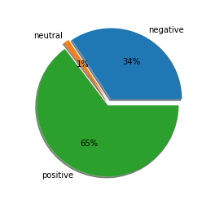
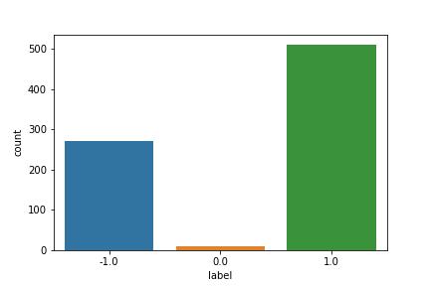
As per the records out of 1000 reviews 789 reviews were verified.
Total verified reviews : 789
Positive reviews: 510 (65%)
Negative reviews: 270 (34%)
Neutral reviews: 9 (1%)
Fig : Reviews

